Slide 1
CAN Based Sensing and Control of an Inverted Pendulum
Nathanael Rake
University of Tulsa
ME7863-04
3 March 2017

Slide 2
Overview
12 Minutes
Motivation
Project Description
Existing Hardware
Methodology
Networking
Sensing
Control
Actuation
Challenges
Deliverables
3 Minutes
Questions and Discussion

Slide 3
Motivation
Controller Area Networks (CAN)
Used in a variety of applications, especially vehicle networking
Driving Forces
Increase in vehicle autonomy and control system sophistication
Importance of having a secure network is increasing
Needs
Tool to demonstrate the importance of network security
Testbed for network attack and security strategies
A teaching tool for future engineers and computer scientists

Slide 4
Project Description
Inverted pendulum system based around a CAN network
Inherent instability demonstrates the efficacy of the network and controller
Nodes on the network will perform incremental yet important tasks
Loss of any one node could compromise the system
Additional connection points allow the insertion of network traffic
Documentation provides information on the inner workings of the system

Slide 5
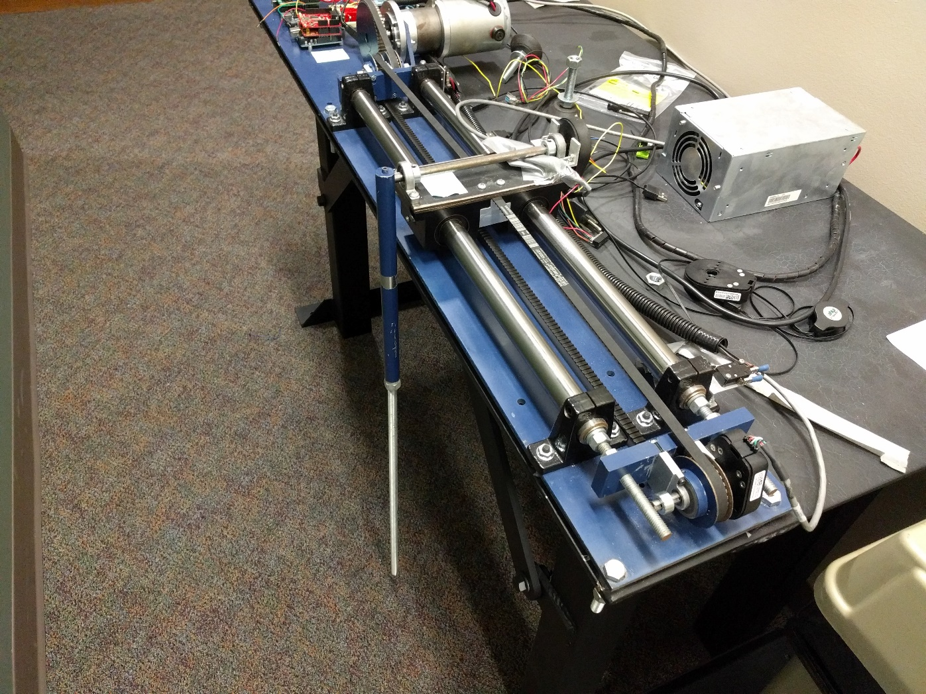
Existing Hardware

Slide 6
Existing Hardware
Pendulum

Slide 7
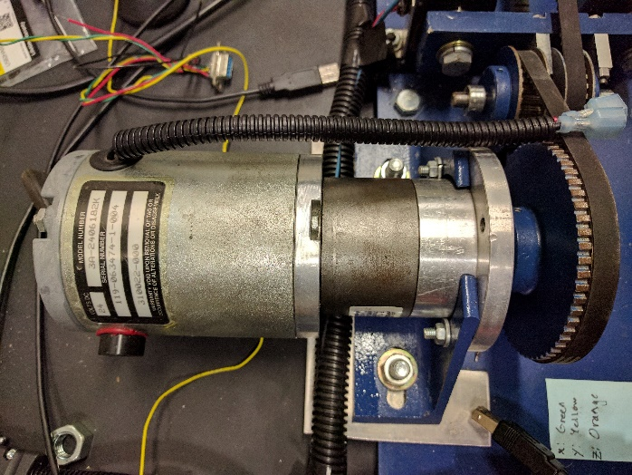
Existing Hardware
24V DC Motor

Slide 8
Existing Hardware
24V DC Power Supply

Slide 9
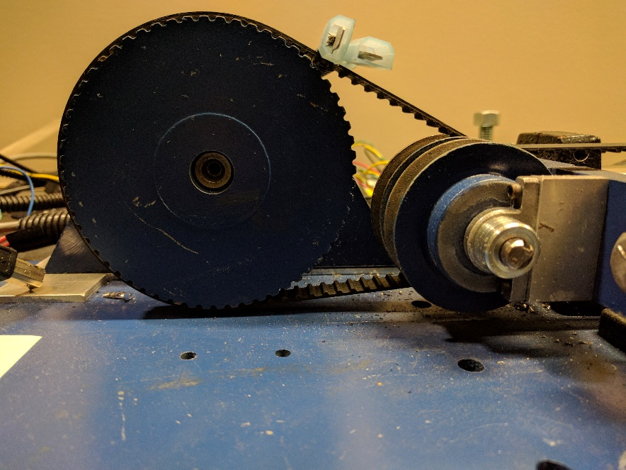
Existing Hardware

Slide 10
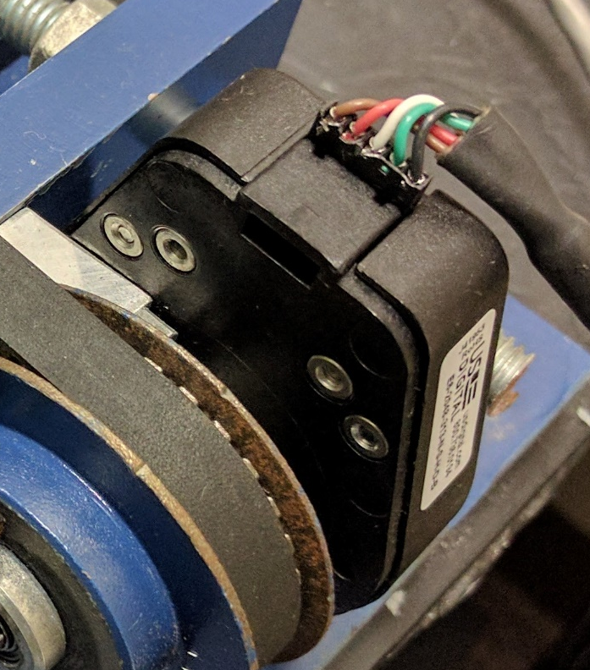
Existing Hardware
Quadrature Encoder

Slide 11
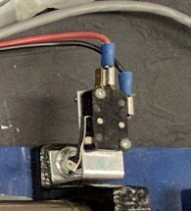
Existing Hardware
Limit Switches

Slide 12
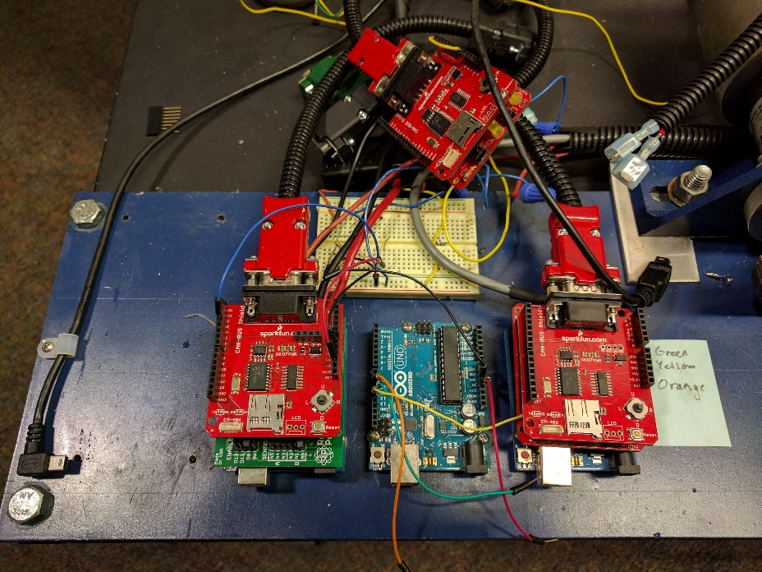
Existing Hardware
Drive and Control Boards

Slide 13
Existing Hardware
Pros
Presents a clear strategy
Reduces manufacturing and assembling difficulties
Reduces build time
Cons
State of each component is unknown
No motor driver
No surviving documentation

Slide 14
Methodology
Pendulum carriage is driven to each limit switch
Determines limit of carriage motion
Pendulum angle is read at steady state
Determines the ‘down’ direction
Pendulum is inverted
Open loop control is proposed
Pendulum carriage is driven along a set trajectory
Pendulum remains inverted

Slide 15
Methodology
Controller
CAN
Actuation System
Encoders
Sensing System
CAN

Slide 16
Methodology: Networking
System: 3 nodes (minimum)
One node monitors the carriage and pendulum positions
One node computes control inputs
One node drives the actuator
Each node is connected over CAN
Messages have preset frequency and length
Messages will have an associated priority
Knowing the states of the limit switches is ‘safety critical’
Knowing the control inputs is not ‘safety critical’

Slide 17
Methodology: Sensing
Sensing node monitors the limit switches and rotary encoders
Limit switches determine the maximum carriage range
Provide security in case of control system failure
Rotary encoder 1 determines carriage position
Numerical differentiation yields carriage velocity
Rotary encoder 2 determines pendulum position
Numerical differentiation yields pendulum angular velocity
CAN Transmissions
Limit switch states
Pendulum position and angular velocity
Carriage position and velocity

Slide 18
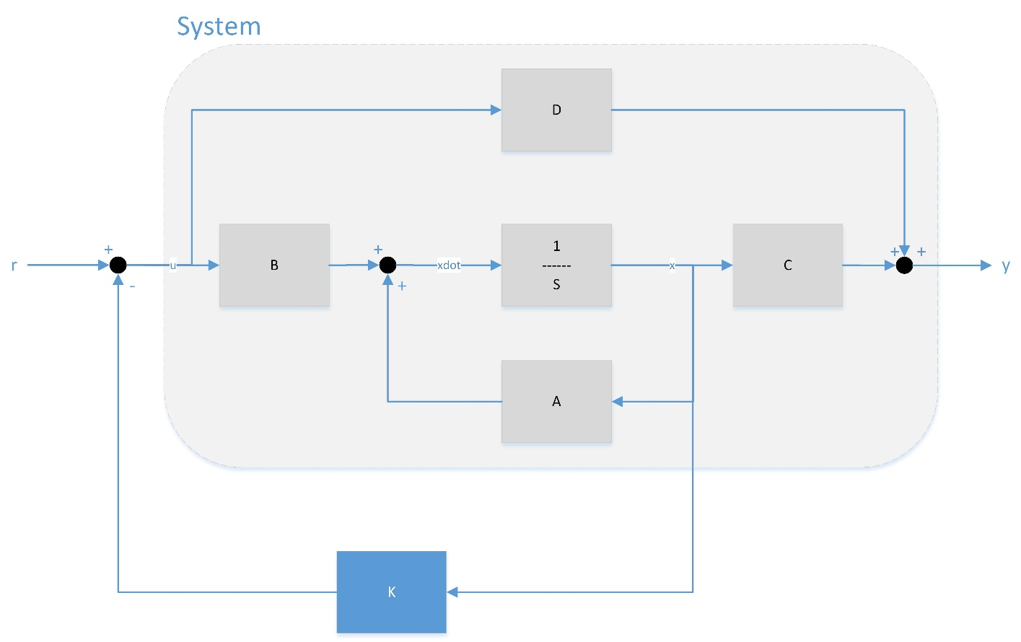
Methodology: Control
Control node provides control inputs to the actuation system
Utilizes full state feedback
States are carriage position, carriage velocity, pendulum position, and pendulum velocity
CAN Transmissions
Control input
Image from Wikipedia

Slide 19
Methodology: Actuation
Actuation node controls the motor driver
Signals the driver to deliver the control input
CAN Transmissions
No required transmissions

Slide 20
Challenges
System testing
No assumptions of functionality
Hardware acquisition
Possible lead times
Developing accurate system models
Parameter measurement (pendulum moment of inertia, carriage mass, etc.)
Effective data transmission
Format
Frequency
Documentation generation
Efficient Testing
Triage
Proactive ordering
Redundant testing

Slide 21
Deliverables
Inverted Pendulum
Sensing Node
Limit Switch Transmission
Position Transmissions
System
Network
Node
Control Node
Actuation Node
Velocity Transmissions
Functional Control Realization
Control Input Transmission
Drivable Carriage
Hardware
Functional Limit Switches
Functional Encoders
Accurate System Model
Functional Motor Controller

Slide 22
Questions and Discussion

